Slide 1
Reports and proposals

Slide 2
Objective
Introduction to reports and proposals
The plain English Guide to Writing Reports
Report - sample
A longer proposal – sample
Checklist

Slide 3
Introduction to reports and proposals
The skills in writing a proposal are the same as in writing a report . However there are certain differences:
Reports
contain information about what happened in the past
aim mainly to provide information
record objective facts
Proposals
examine what may happen in the future
aim mainly to persuade the reader to make a specific decision
express opinions – supported by objective facts

Slide 4
The plain English guide to writing a report
The main stages of writing a report
defining the purpose
investigating the topic
organizing the report into sections
order of presentation
order of writing
numbering sections and paragraphs
planning the writing
revision

Slide 5
The plain English guide to writing a report
Defining the purpose
This help you to clear about:
why you are writing?
what to include?
what to leave out?
who your readers are?
If you can express the purpose in a single sentence, so much the better.

Slide 6
The plain English guide to writing a report
Investigating the topic
depend on topic and purpose
need to read, interview, experiment and observe
get advice from someone more experienced

Slide 7
The plain English guide to writing a report
Organizing the report into sections
Report can be set out in eight parts:
title or title page
contents list
abstract
introduction discussion
summary and conclusions
recommendations
appendix
** A short report won’t need a title page
** Abstract needed in formal reports, such a report of scientific research

Slide 8
The plain English guide to writing a report
The introduction should be brief and answer any of the following question
what is the topic?
who asked for the report and why?
what is the background?
what is your method of working? If the method is long and detailed, put in appendix
what were the sources? If there are many, put them in a appendix

Slide 9
The plain English guide to writing a report
Order of presentation
The sections in the brackets are not always included
Long reports
Title or title page
(Contents list)
(Abstract)
Introduction
Summary and conclusions
Recommendations
Discussion
(Appendix)

Slide 10
The plain English guide to writing a report
Short reports
Title
Introduction
Discussion
Summary and conclusions
Recommendations
(Appendix)

Slide 11
The plain English guide to writing a report
Order of writing
The writing order in such a way that each section you finish help you to write the next one
Introduction
Discussion
Summary and conclusions
Recommendations
(Abstract)
Title or title page
(Contents list)
(Appendix)
** After writing all the sections, read and revise them. Rewrite sections if necessary

Slide 12
The plain English guide to writing a report
Planning the writing
Make some kind of plan, before you write
First, outline all facts, ideas, observation and so on
And then organize them, group them, assess them for strength and relevance in the report
Put headings like “Intro”, “Discussion” and “Title”
Mind mapping is other technique of planning.
Should have coherence in writing style

Slide 13
The plain English guide to writing a report
Numbering sections and paragraphs
Should have contents list at the start of report
Add cross-refer if necessary
Label sections and paragraphs, to keep as simple as possible
Use capital letters to label sections and number to label paragraphs

Slide 14
The plain English guide to writing a report
Revision
Read critically what you have written
Ask someone else to read it for you
Revise for clearness, conciseness and persuasiveness
Revise for language and structure
Rewrite parts that don’t work

Slide 15
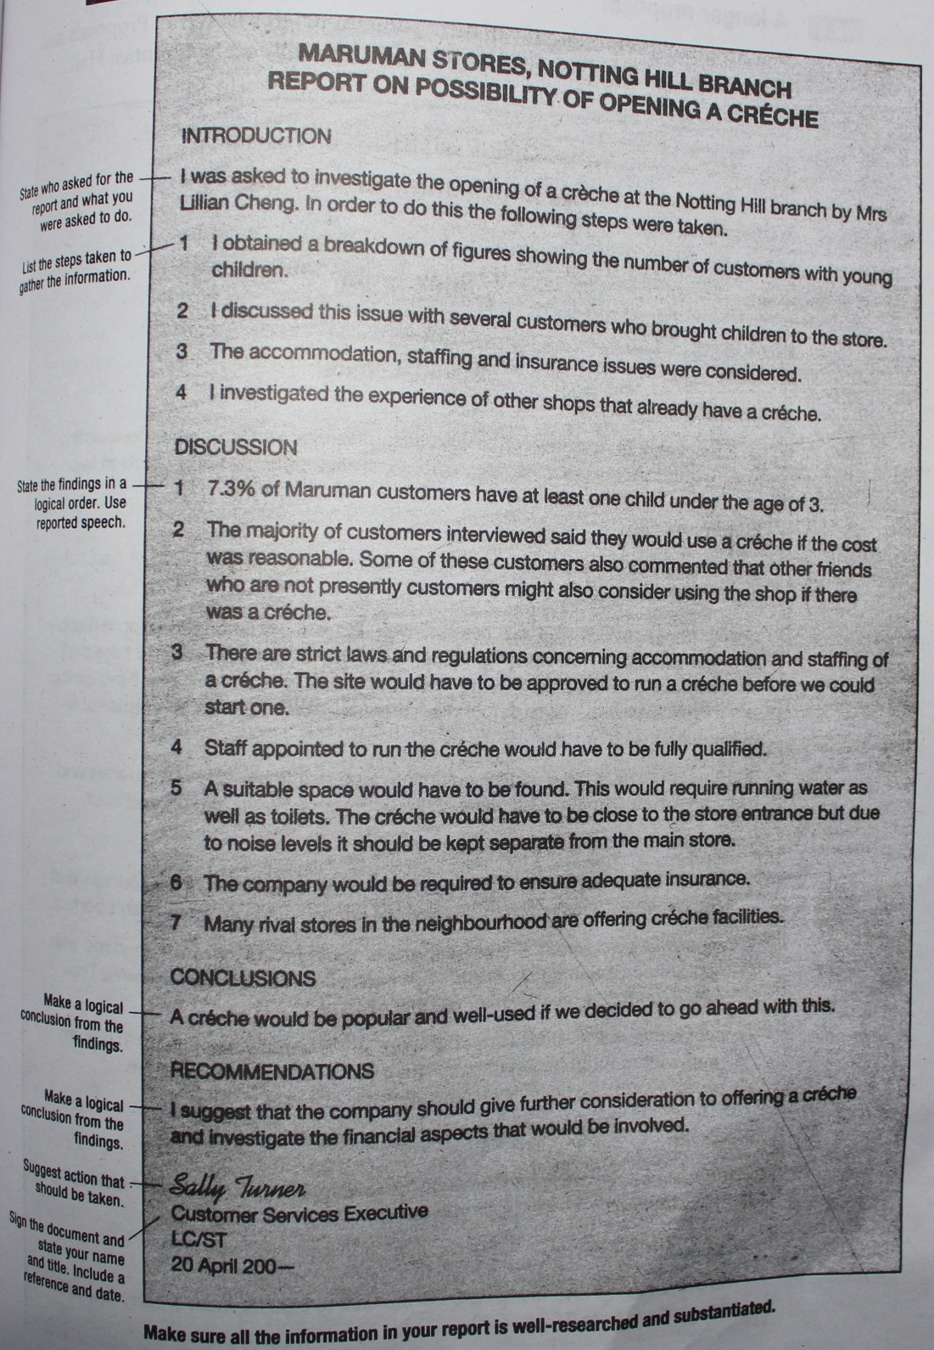
Reports - sample

Slide 16
Reports - sample

Slide 17
Proposals - Sample

Slide 18
Proposals - Sample

Slide 19
Proposals - Sample

Slide 20
Checklist
Plan reports and proposals very carefully before you start writing
Use sub-headings to organize your document into sections
Use everyday, straightforward English
Avoid jargon, and explain any technical term
Keep your sentences to 15-20 words
Use active verbs wherever possible
Be clear and concise
Write sincerely and personally
Draft your response first
Ask someone else to read and check your report meet all objectives, and that it is readable and accurate

Slide 21
Assignment Re-write the abstract of any report/ paper Dead-line : 28-05-2013

